Slide 1

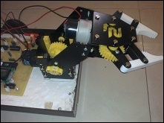

A seminar on Pick & Place Robot
Presented By-
VINOD KUMAR
31804106

Slide 2
CONTENTS:
DEFINITION
IDEAL TASK AND CONTROL
TYPES OF ROBOT
ROBOTIC TERMINOLOGY & CONFIGURATION
ALGORITHM AND BLOCK DIAGRAM
EQUIPMENTS USED
CIRCUIT DIAGRAM
APPLICATIONS
ADVANTAGES AND DISADVANTAGES
FUTURE APPLICATIONS
CONCLUSION

Slide 3
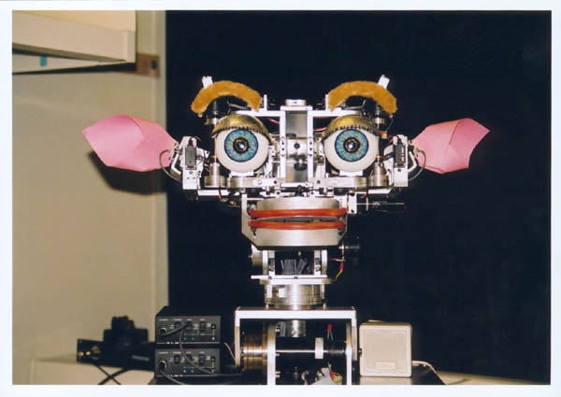
“A robot is a reprogrammable, multifunctional manipulator designed to move material, parts, tools, or specialized devices through variable programmed motions for the performance of a variety of tasks.” (Robot Institute of America)
Definition:-

Slide 4
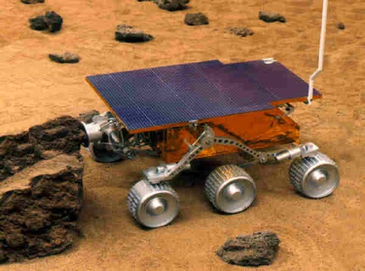
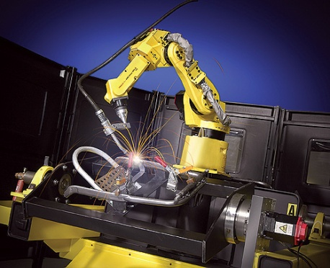
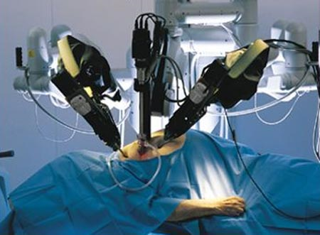
Ideal Tasks
Tasks which are:-
Dangerous
Space exploration
chemical spill cleanup
disarming bombs
disaster cleanup
Boring and/or repetitive
Welding car frames
part pick and place
manufacturing parts
High precision or high speed
Electronics testing
Surgery
precision machining

Slide 5
Control
Open loop, i.e., no feedback, deterministic.
Closed loop, i.e., feedback, maybe a sense of
touch and/or vision.

Slide 6
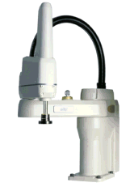
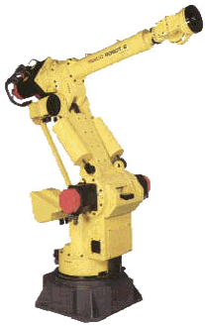
Types of robots
Pick and place
Moves items between points
Continuous path control
Moves along a programmable path
Sensory
Employs sensors for feedback
A SCARA robot (Selective Compliant Articulated Robot Arm): A pick-and-place robot with angular x-y-z positioning
A six-axis industrial robot, but an additional amount is often spent for tooling and programming.

Slide 7
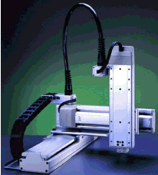
Pick and Place
Moves items from one point to another
Does not need to follow a specific path between points
Uses include loading and unloading machines, placing components on circuit boards, and moving parts off conveyor belts.
A Cartesian robot for picking and placing circuits on circuit-boards

Slide 8
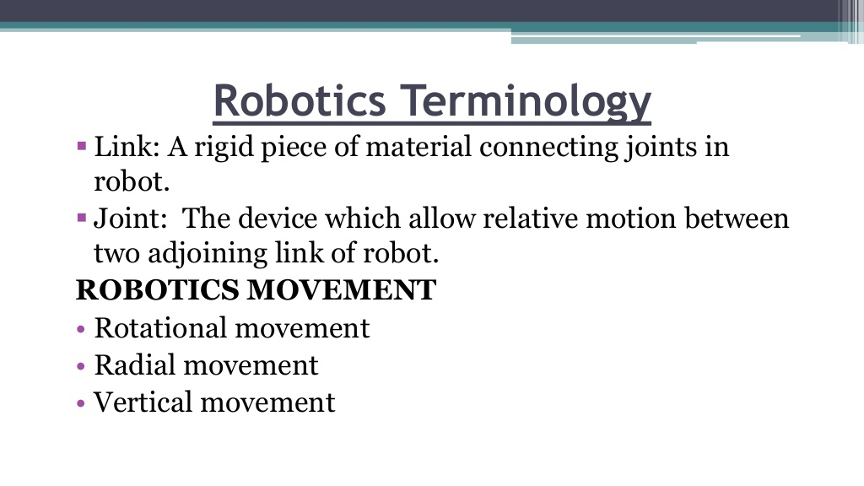

Slide 9
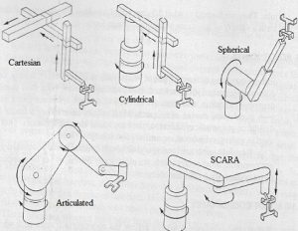
CONFIGURATIONS:

Slide 10
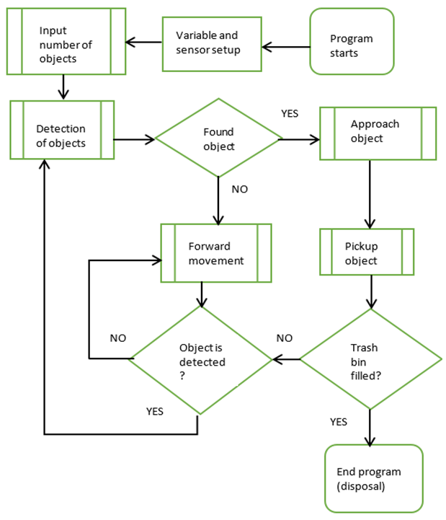
ALGORITHM

Slide 11
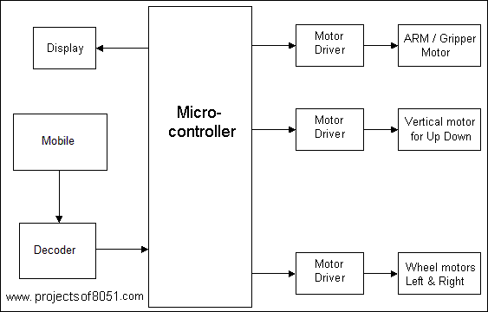
BLOCK DIAGRAM :

Slide 12
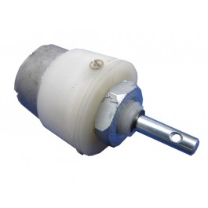
DC MOTER
These are very commonly used in robotics. DC motors can rotate in both directions depending upon the polarity of current through the motor. These motors have free running torque and current ideally zero. These motors have high speed which can be reduced with the help of gears and traded off for torque. Speed Control of DC motors is done through Pulse Width Modulation techniques, i.e. sending the current in intermittent bursts. PWM can be generated by 555 timer IC.Varying current through the motor varies the torque.

Slide 13
GRIPPER ARM :
The gripper module is state of the art robotic arm which can be used in various 'pick and place' kind of robots. It works on DC Motor (9 to 12V DC).
Change in rotation direction of the DC Motor, generates Jaw Open & Close Action.
The DC motor can be easily be controlled with the help of DPDT Switch (manual mode) or with the help of any micro controller along with L293D Motor Driver module.

Slide 14
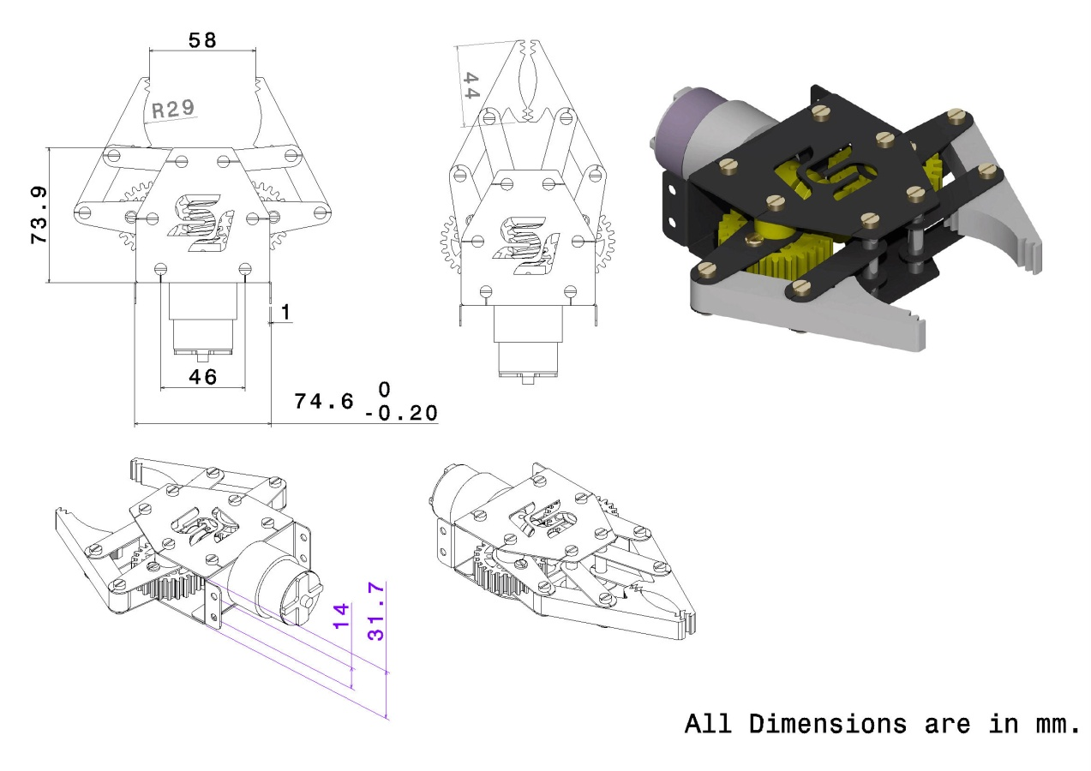

Slide 15
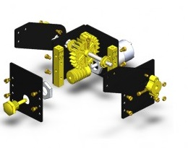
:
LIFTER ASSEMBLY:
It is made from laser cut Metal and acrylic. There is a worm gear and spur gear assembly which is attached with a DC motor (9 to 10 volt) to provide torque so that gripper can pick and lift the load.
• | Gripper assembly Plates.
• | Fiber Grippers-2nos.
• | 45 RPM Motor-1nos.
• | Worm Gear-1nos.
• | Spur Gear-2nos.
• | Different Screws and nuts.

Slide 16
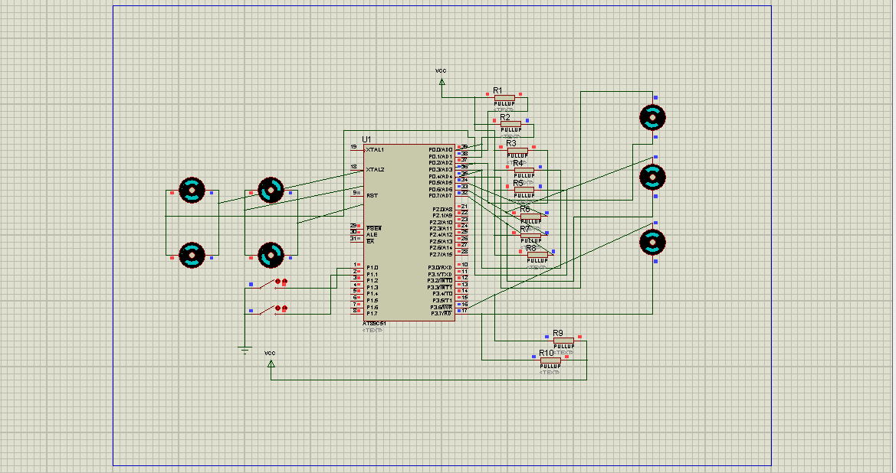
CIRCUIT DIAGRAM:

Slide 17
SOFTWARE TOOLS :
KEIL SOFTWARE :
Keil compiler is software used where the machine
language code is written and compiled. After compilation, the
machine source code is converted into hex code which is to be
dumped into the microcontroller for further
processing. Keil compiler also supports C language code.
DRIVERS&ARM ABSTRACTION :
The drivers provide the most basic interaction with the hardware, simply reading or writing a value when requested.
the drivers would provide some extra functionality, such as changing the register address written in the PWM.
For example, when we want the arm to move, it is easier to issue a move command that specifies the motor to move, the direction, the speed and the distance to move in one call.

Slide 18
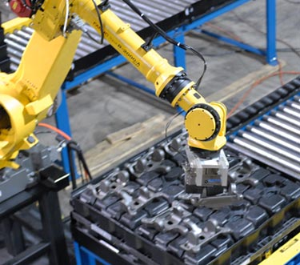
APPLICATIONS
Parts Transfer
Bonding and Sealing Robots offer many benefits.
They perform applications with exceptional consistency and repeatability.
They remove workers from taxing, tedious, and often dangerous duties.

Slide 19
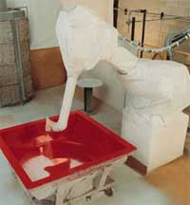
Dispensing
Dispensing jobs require materials to be moved from one location to another. The consistent, accurate movements of industrial robots make them well suited for dispensing
Advantages of Dispensing Robots:-
Precision
Repeatability
Work envelope
Payload capacity
safety

Slide 20
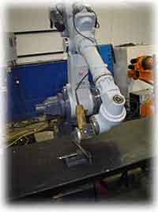
DEBURRING
Robotic deburring is the material removal process used to take burrs, sharp edges, or fins off metal parts.
DEBURRING IMPACTS
VALUE: Automated deburring cells grind, roll and file metal parts precisely.
PRODUCTION: The robot can work long hours without fatigue to produce more throughput.
SPEED: Automation is faster and more efficient than its human counterparts.
SAVINGS: Deburring robots improve the application so product is created at a faster rate.

Slide 21
ADVANTAGES
Speed - Pick and place robots allow for faster cycle times.
Accuracy - Robotic systems are more accurate and consistent than their human counterparts.
Production - Work cells create more because they perform applications with more accuracy, speed and tirelessness. The consistent output of a robotic system along with quality and repeatability are unmatched
Reliability - Robots can work 24 hours a day, seven days a week without stopping or tiring.

Slide 22
Cont…
Flexibility - Pick and place robots can be reprogrammable and tooling can be interchanged to provide for multiple applications.
Savings - Managers are realizing the longtermsavings with a pick and place robotic workcell rather than the operation they are currently doing. An increase in output with a material handling robotic system has saved factories money.
Affordability - With the advancements intechnology, and affordable robotics becoming available at less cost, more pick and place robotic cells are being installed for automation applications.

Slide 23
DISADVANTAGES
Due to limited of its application is confined to few areas.
If component is not in the reach of robot it take some time and may not reach location and pick object.

Slide 24
FUTURE APPLICATION
Coal mining
Military Operation
Fire fighting Operation
Undersea Robots
Garbage Collection and Waste

Slide 25
CONCLUSION
Some industrial works are harmful for humans, robots are mainly used for reducing the risk process and time consumption and avoid labour.
Humans are tired for hard work such as assembly line, material handling etc. So, Pick & Place Robots are the best alternate solution.

Slide 26
THANK YOU

